Slide 1


Lecture Notes:
Spreadsheet software

Slide 2
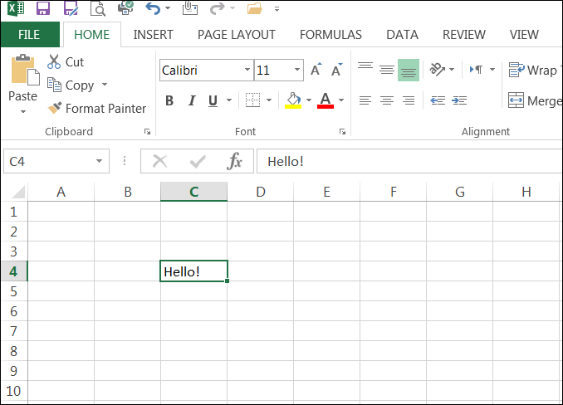
Spreadsheet software
A spreadsheet is an application (program) where data is arranged into small boxes on a grid.
Each box is known as a cell.
The data in each cell can be manipulated and used in calculations.
Spreadsheet software is one of the most widely used computer applications.

Slide 3
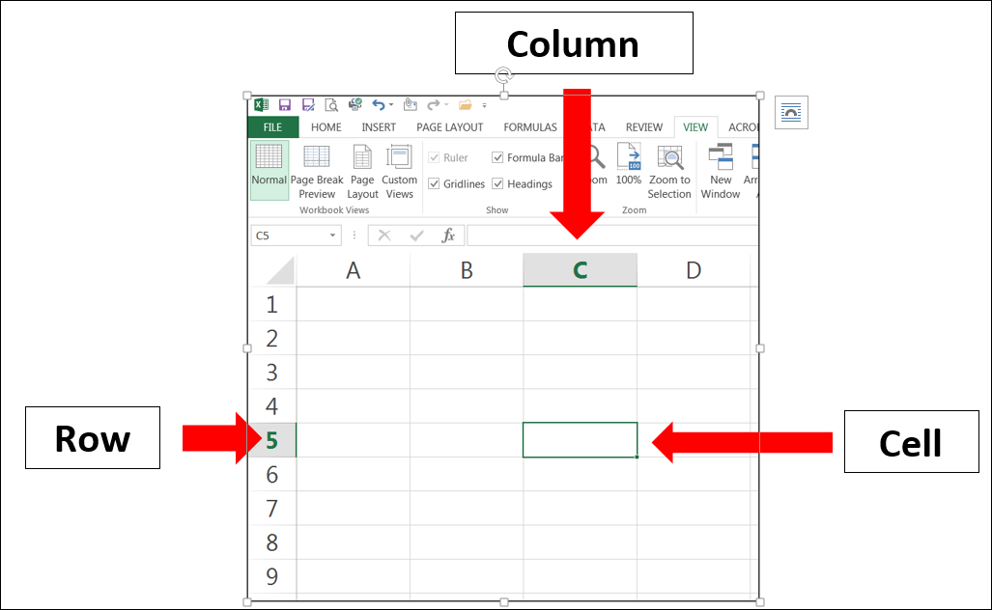
Spreadsheet grid layout
Each grid in a spreadsheet is made up of columns, rows and cells. Columns go down the page and are labelled at the top by a letter (e.g. A).
Rows go across the page and are labelled at the side by a number (e.g. 1).
Cells are individual boxes within the grid. Each cell has an unique address. The address of the cell highlighted is C5.

Slide 4
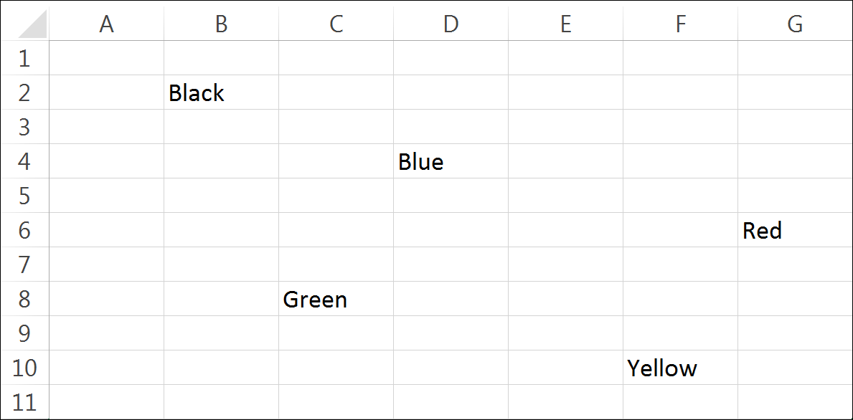
Activity – in which cell address is each colour located?

Slide 5
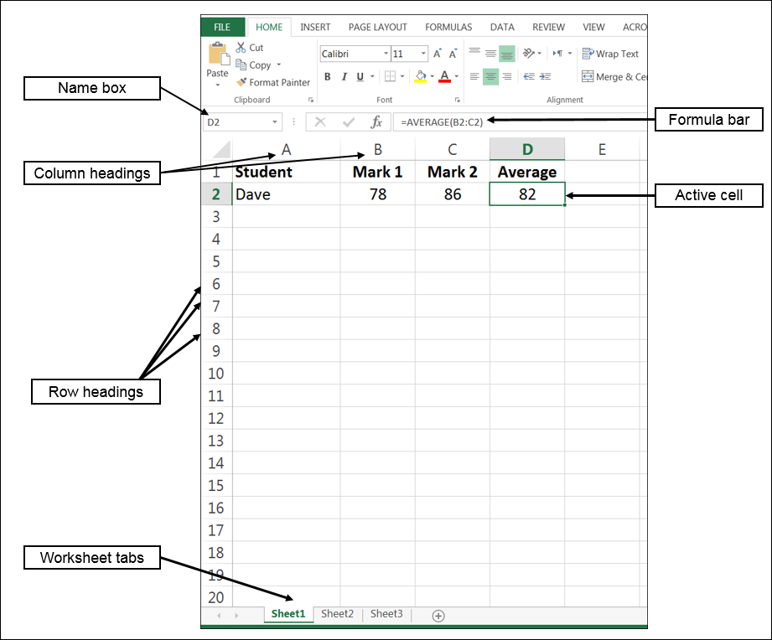
Spreadsheet user interface
Active cell The cell that is currently selected is known as the active cell.
Formula bar The value of the active cell appears in the formula bar. If the value is the result of a calculation the formula will appear here.
Name box Shows the address of the active cell.
Worksheet tabs Each spreadsheet contains a number of worksheets (or pages).

Slide 6
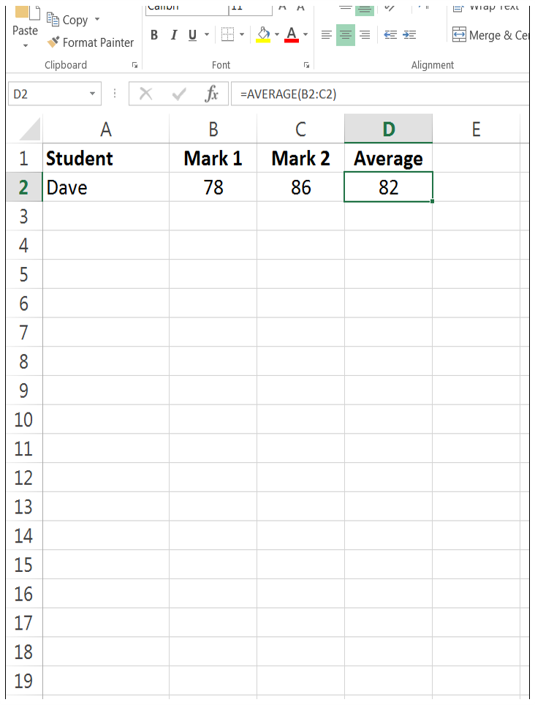
Cell contents
Each cell in a spreadsheet can contain one of following types of data: Label Any text, characters or symbols entered is known as a label.
Values All numbers entered are values, including decimal numbers.
Formulas Mathematical equations can also be entered that perform calculations
Example In cell D2 a formula has been input to calculate the average of Mark 1 & Mark 2

Slide 7
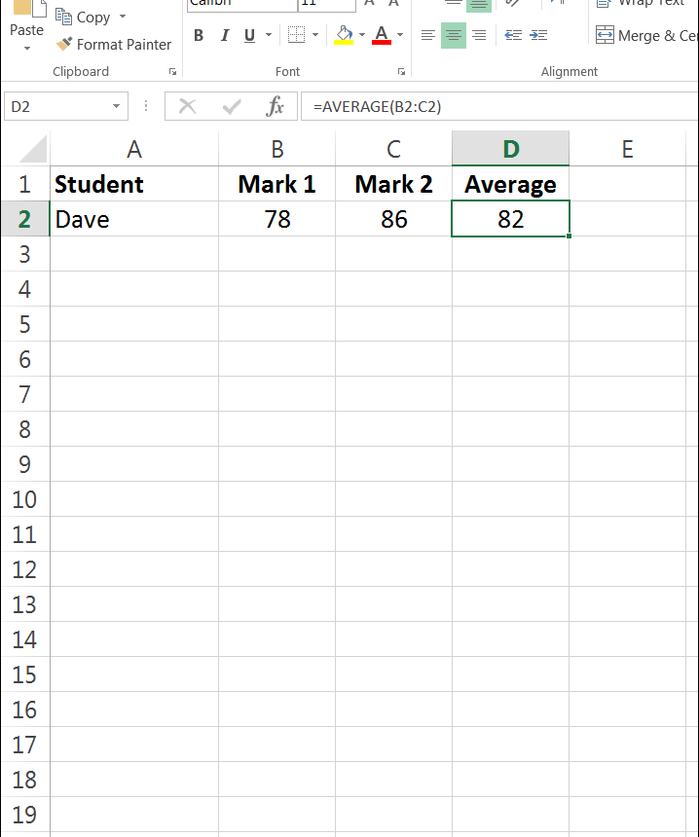
Activity – spreadsheet task
Create the spreadsheet that you can see in the image.
Steps:
Open spreadsheet software
Type in the data in row 1 – Student, Mark 1, Mark 2 and Average
Select labels and make bold
Type in data in row 2 – Dave, 78 and 86
In cell D2 type =Average(B2:C2) – this is a formula
Tip: Formulas always start with an = sign
Save the spreadsheet as first_spreadsheet
Upload to eLearn

Slide 8
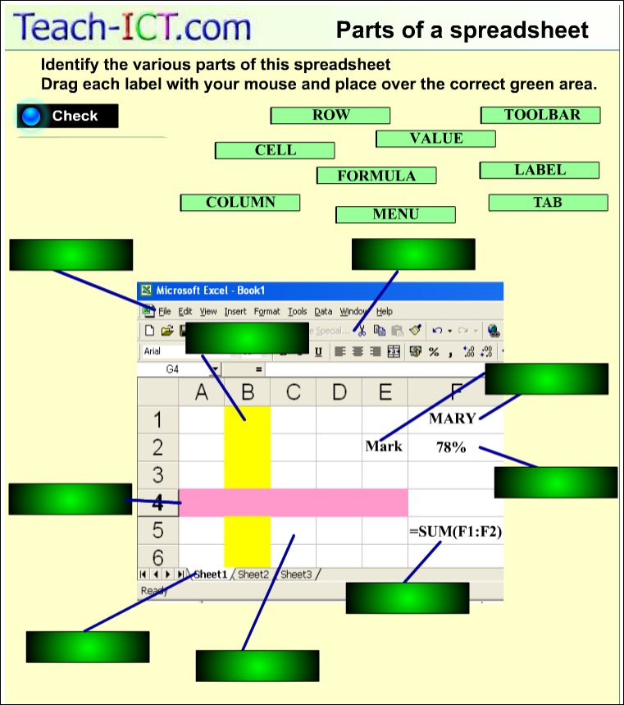
Activity – user interface
Go to the website Teach-ICT and complete the matching activity
http://www.teach-ict.com/gcse_new/spreadsheets/spreadsheets/miniweb/pg3.htm
This activity requires Flash to be installed.

Slide 9
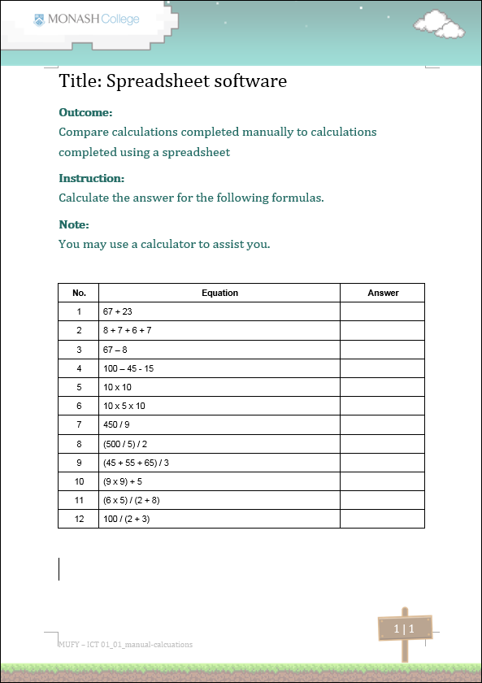
Activity – manual calculations
Download and complete the manual calculations worksheet from eLearn.
Use a calculator to assist you!

Slide 10
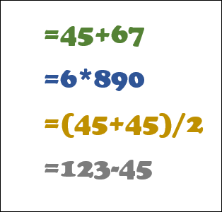
Spreadsheet formulas
Mathematical formulas can be input into any cell.
To create a formula the first character in a cell must be an = sign.
Mathematical operators can be used in the formula.
Operators include +, /, -, *, <, >, etc.
Operators allow data to be manipulated.

Slide 11
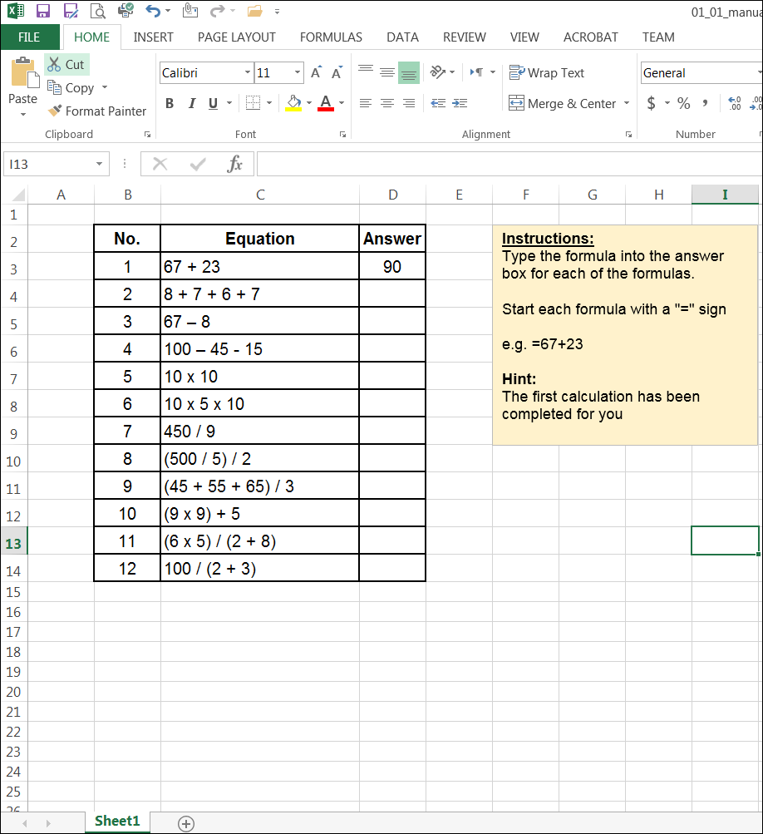
Activity – spreadsheet calculations
Now download the manual calculations spreadsheet and write formulas to complete the calculations.
You will not need a calculator to assist you.
Think: Which method was better – manual calculations or spreadsheet calculations?
What is one advantage of a spreadsheet over manual calculations?
What is one advantage of manual calculations over a spreadsheet?
Pair:
Share:

Slide 12
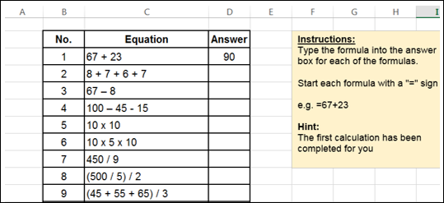
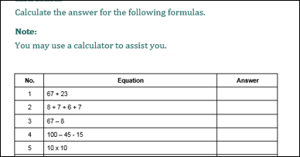
Activity – think, pair, share!
Think: Which method was better – manual calculations or spreadsheet calculations?
What is one advantage of a spreadsheet over manual calculations?
What is one advantage of manual calculations over a spreadsheet?
Pair:
Discuss these questions with the students sitting next to you.
Share:
Share your groups findings with the class.

Slide 13

Post-class activity
Write notes on page 1 of the workbook with the definitions of the key words listed on the left.

